Slide 1
HERS: Modeling Influential Contexts with Heterogeneous Relations for Sparse and Cold-start Recommendation
Authors: Liang Hu^{1,2}, Songlei Jian^{1,3}, Longbing Cao¹ , Zhiping Gu⁴, Qingkui Chen², Artak Amirbekyan
¹University of Technology Sydney
²University of Shanghai for Science and Technology
³National University of Defense Technology
⁴Shanghai Technical Institute of Electronics Information

Slide 2
Outline
Heterogeneous Relations in Recommender Systems
Modeling HERS with Influential Context Units
Experiment Details
Conclusion and Future Direction

Slide 3
Outline
Heterogeneous Relations in Recommender Systems
Modeling HERS with Influential Context Units
Experiment Details
Conclusion and Future Direction

Slide 4
Why modeling heterogeneous relations in RS?
The basic problem in RS is to study the user-item relation.
Besides user-item relation, user-user relation (e.g. social network) and item-item relation (e.g. compatibility)
In fact, user-user relation and item-item relation have direct influence on user selection, so they should be considered when modeling RS.

Slide 5
Influence contexts for making decision

Slide 6
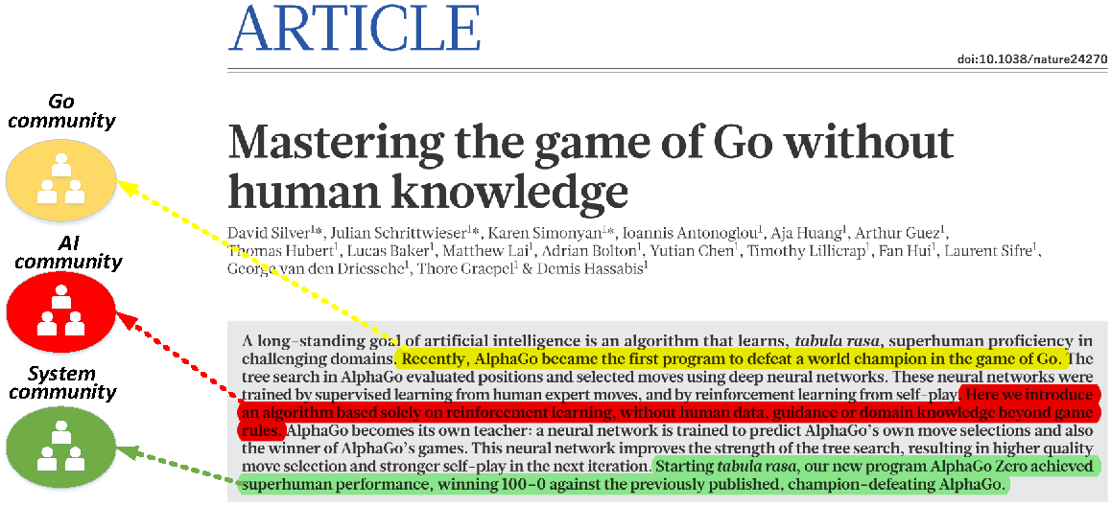
Why modeling attraction?
Second, the attraction is a subjective feeling which is often different from person to person.
For example,
Readers in Go community may be attracted by the target problem, i.e., Go playing, of this scientific paper while readers in AI community may be attracted by the technical methods.

Slide 7
Datasets
We collect user watch records from the MovieLens 1M dataset.
https://grouplens.org/datasets/movielens/1m/
Story and cast data are provided the mapping from MovieLens ID to DBPedia URI
https://github.com/sisinflab/LODrecsys-datasets/tree/master/Movielens1M

Slide 8
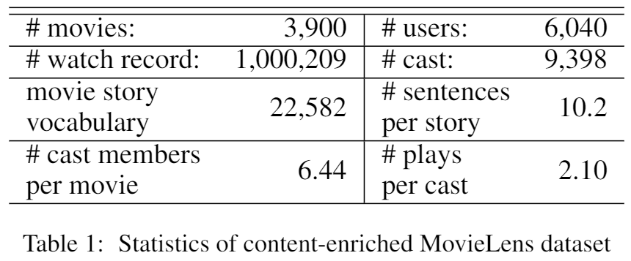
Statistics of the Enriched Dataset

Slide 9
Training and Testing Sets
Released movie recommendation: we randomly held out 20% user watch records as the testing set, and the remainder were served as the training set.
New movie recommendation: we randomly selected 10% movies and held out all their watch records from the dataset, and the remainder of 90% movies and their watch records were used for training.
For each hold-out test sample in above two testing sets, we randomly draw ten noisy samples to test whether the testing methods can rank the true sample at a top position out of noisy samples.

Slide 10
Comparison Methods
CENTROID: We create user profiles using the centroid of all word embedding vectors from the users' movie stories. Then, we rank recommendations by the similarity between the user profile and the controid of word embedding vectors of movie story.
CTR: Collaborative topic regression performs user regression over the latent topic distribution of movie stories learned from LDA.
CWER: Similar to CTR, we create the collaborative word embedding user regression (CWER) to perform regression over the centroid word embedding vector of each movie story initialized by GloVe embeddings.
MLAM: This is the full multilevel attraction model proposed in this paper.
MLAM-S: This is the single-modal version MLAM that only has the story attraction module.
MLAM-C: This is the single-modal version MLAM that only has the cast attraction module.

Slide 11
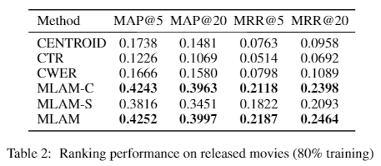
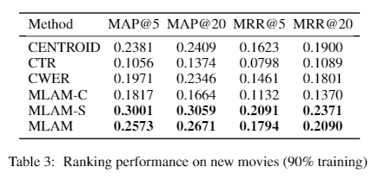
Ranking Performance
Recommendation accuracy on released movies and new movies

Slide 12
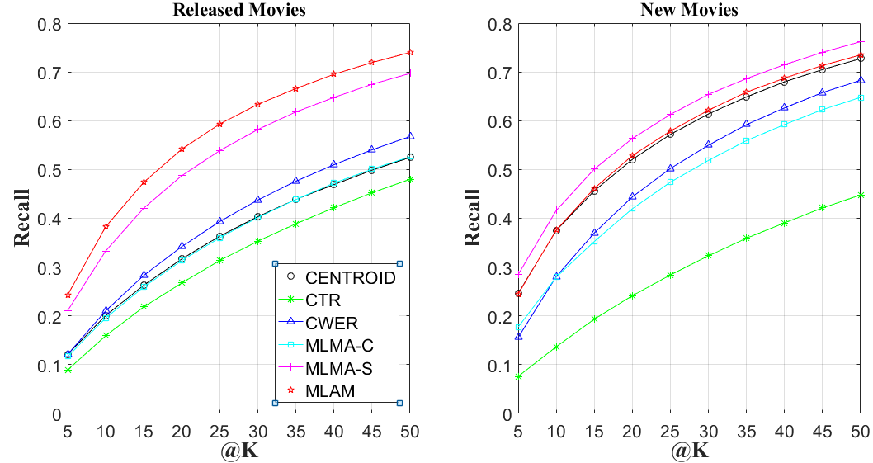
Recall on Release Movies and New Movies

Slide 13
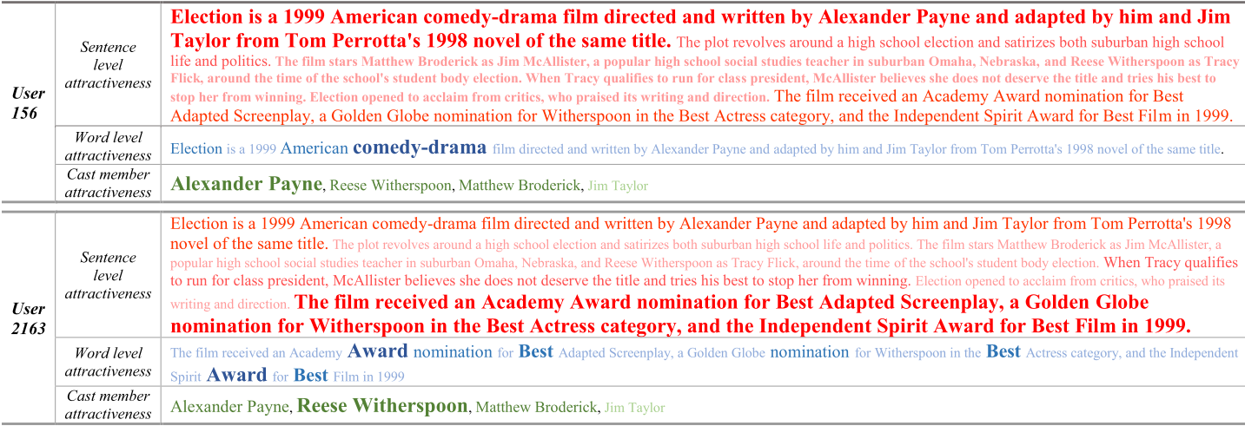
Visualization and Interpretation
Statistical attractiveness on movie Election (1999) w.r.t. sentences, words in the most attractive sentences and cast members.
The larger size and deeper color of font denote the larger attractiveness weight is assigned.

Slide 14
Conclusion
We model human attraction on new contents, using movie content as the study case, to capture and interpret the motivation on user selections.
A multimodal neural network model with subjective attention mechanism is designed to learn the multilevel personal attraction on the story and the attraction on the cast members of a movie.
Extensive experiments on a real-world dataset are conducted to evaluate the above design. All results show that our approach can achieve comparable performance with the state-of-the-art methods.
We demonstrate the statistical user attractiveness on movies to interpret the recommendation results.

Slide 15
Open issues and directions
More advanced approaches involving Psychology, Neuroscience, Brain science, are demanded to precisely model attraction.
Attraction modeling on more data types as well as text, e.g. images, videos, audios.
Attraction is quite subjective, which changes with context
Incorporating contextual information for modeling context-aware attraction is more preferable

Slide 16
Question?

